Slide 1
INTRODUCTION TO COMPUTER GRAPHICS

Slide 2
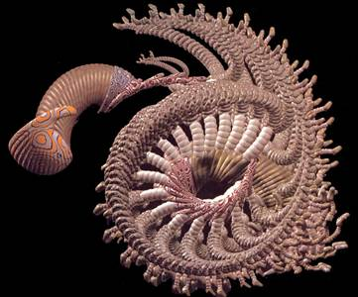
What is Computer Graphics?
Computer graphics generally means creation, storage and manipulation of models and images
Such models come from diverse and expanding set of fields including physical, biological, mathematical, artistic, and conceptual/abstract structures
Frame from animation by William Latham, shown at SIGGRAPH 1992. Latham creates his artwork using rules that govern patterns of natural forms.

Slide 3
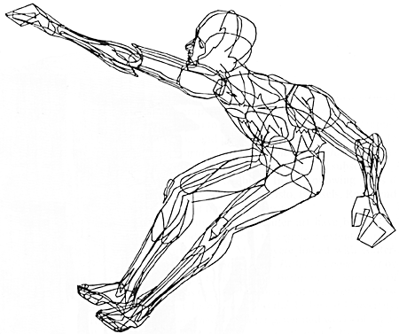
What is Computer Graphics?
William Fetter coined term “computer graphics” in 1960 to describe new design methods he was pursuing at Boeing for cockpit ergonomics
Created a series of widely reproduced images on “pen plotter” exploring cockpit design, using 3D model of human body.
“Perhaps the best way to define computer graphics is to find out what it is not. It is not a machine. It is not a computer, nor a group of computer programs. It is not the know-how of a graphic designer, a programmer, a writer, a motion picture specialist, or a reproduction specialist.
Computer graphics is all these – a consciously managed and documented technology directed toward communicating information accurately and descriptively.”
Computer Graphics, by William A. Fetter, 1966

Slide 4
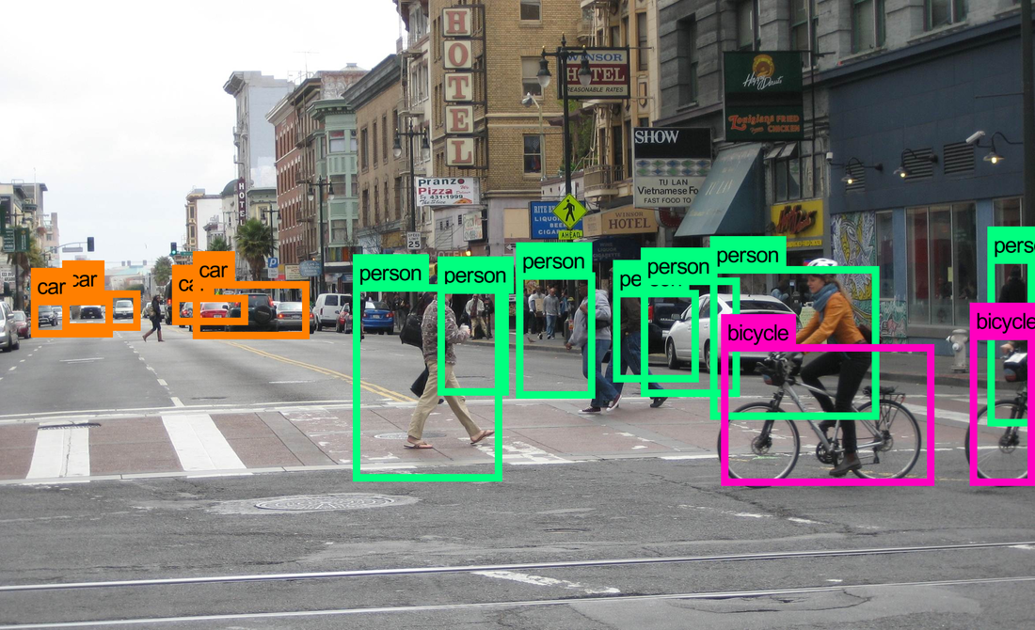
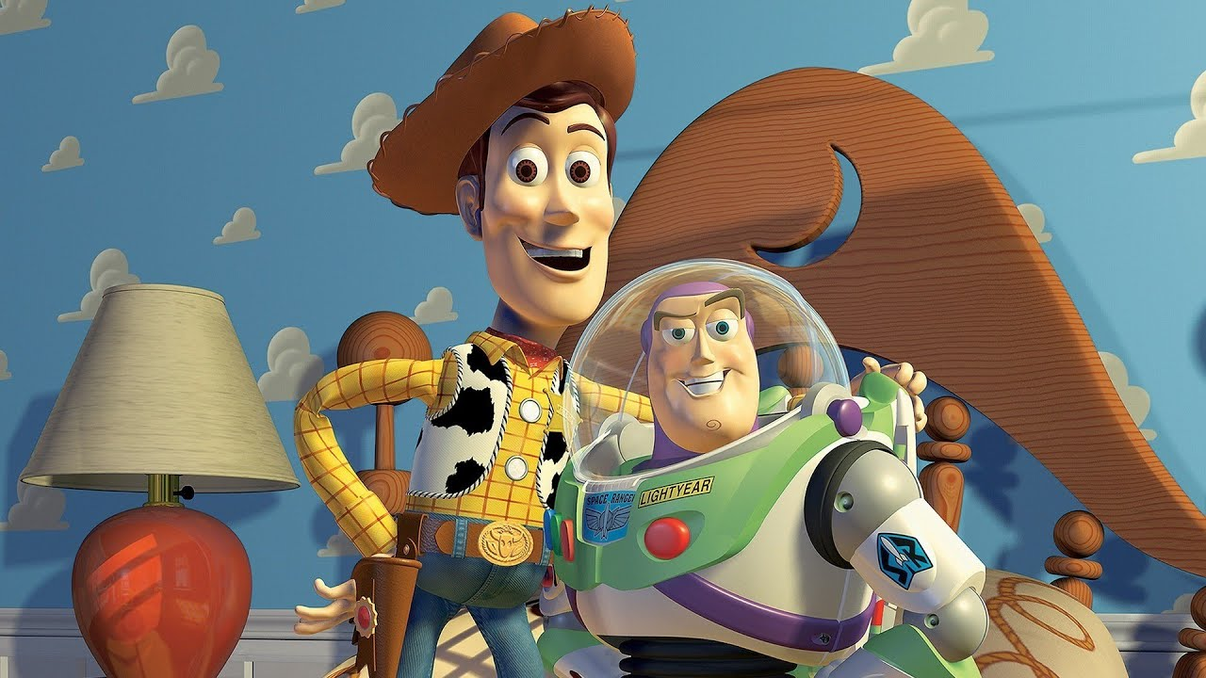
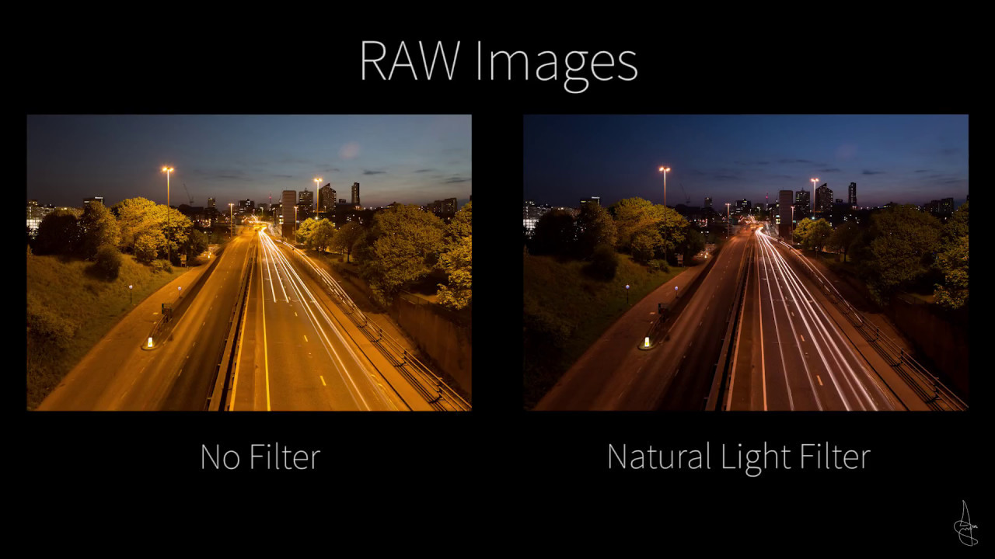
Differences
Computer vision: Extracting information from the contents of an input image or video frame.
Ex: Face Recognition, Autonomous Driving
Computer graphics: Creating an image from scratch using computer.
Ex: Animated Movies
Digital image processing: Processing raw input images to perform different operations.
Ex: Apply Filter on an Image, Noise Reduction, Compression

Slide 5
Applications of CG
Entertainment & Gaming: Visual Effects, Animation, Video Games, VR/AR Experiences.
Design & Engineering: CAD Modeling, Architectural Visualization, Product prototyping.
Education & Training: Virtual Labs, Interactive simulations, VR-based Learning.
Medical & Scientific Visualization: MRI/CT Imaging, Surgery Simulation, Data and Astrophysical Visualization.
User Interfaces & Marketing: GUIs, Graphic Design, 3D Product Visualization, Digital Ads.

Slide 6
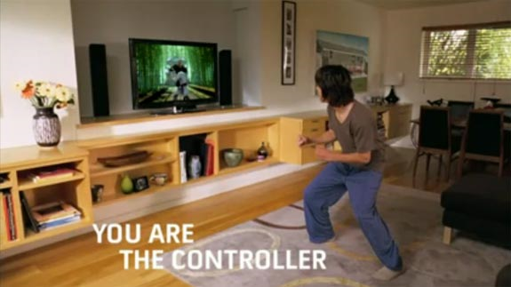
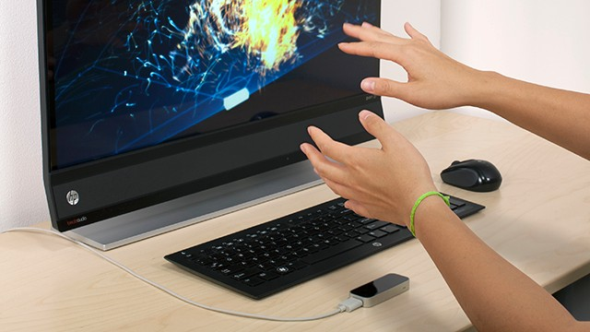
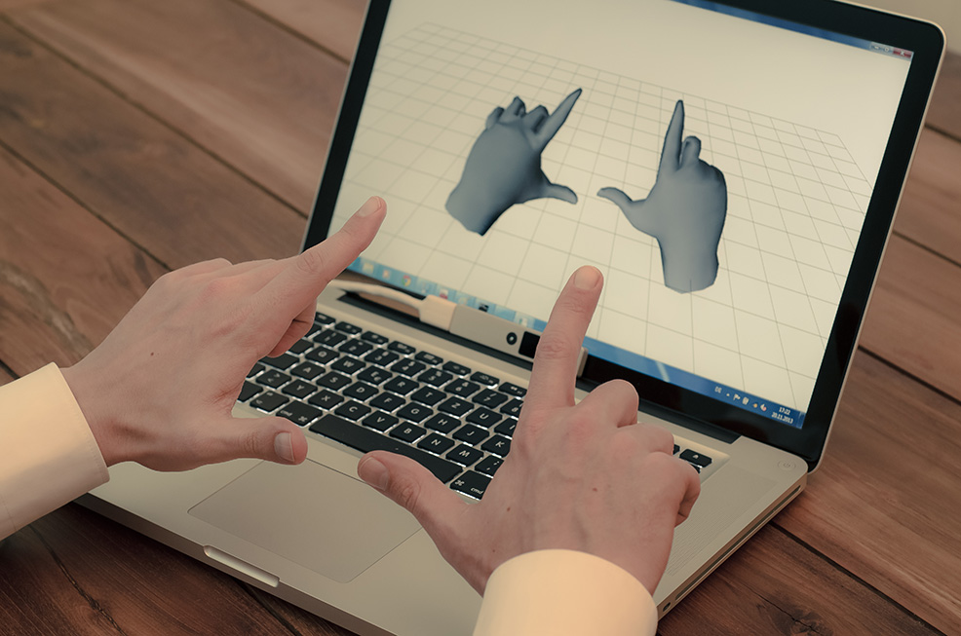
Input Methods in Computer Graphics
Keyboard and Mouse: Traditional devices for controlling software, navigation, and object manipulation.
Graphics Tablets: Used for digital drawing and illustration.
Touchscreens: For direct interaction with graphical elements.
3D Scanners: Capture the 3D structure of objects to create digital models.
Body as Interaction Device:
Xbox Kinect
Leap Motion
Nimble UX

Slide 7
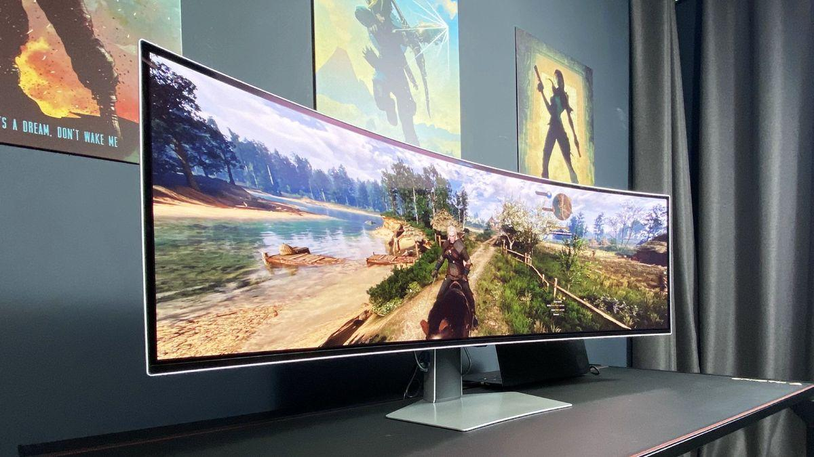
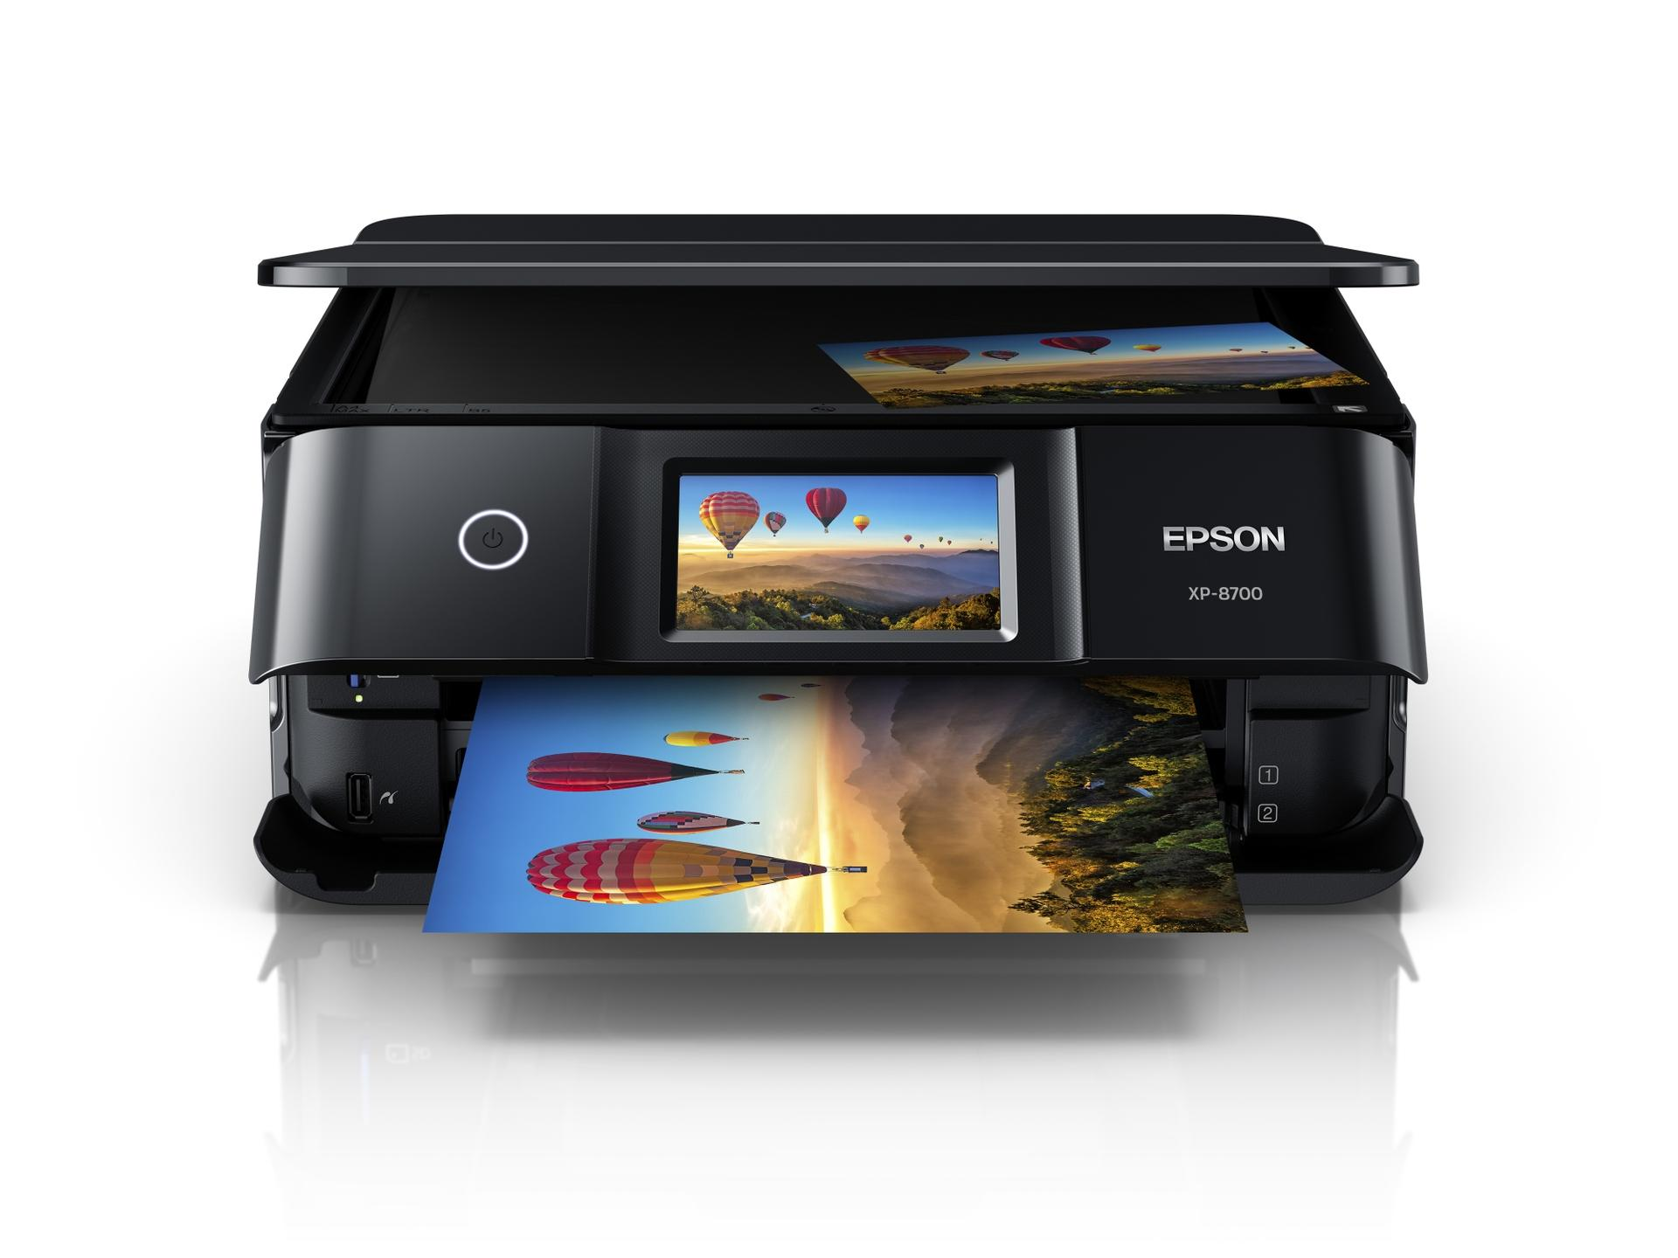
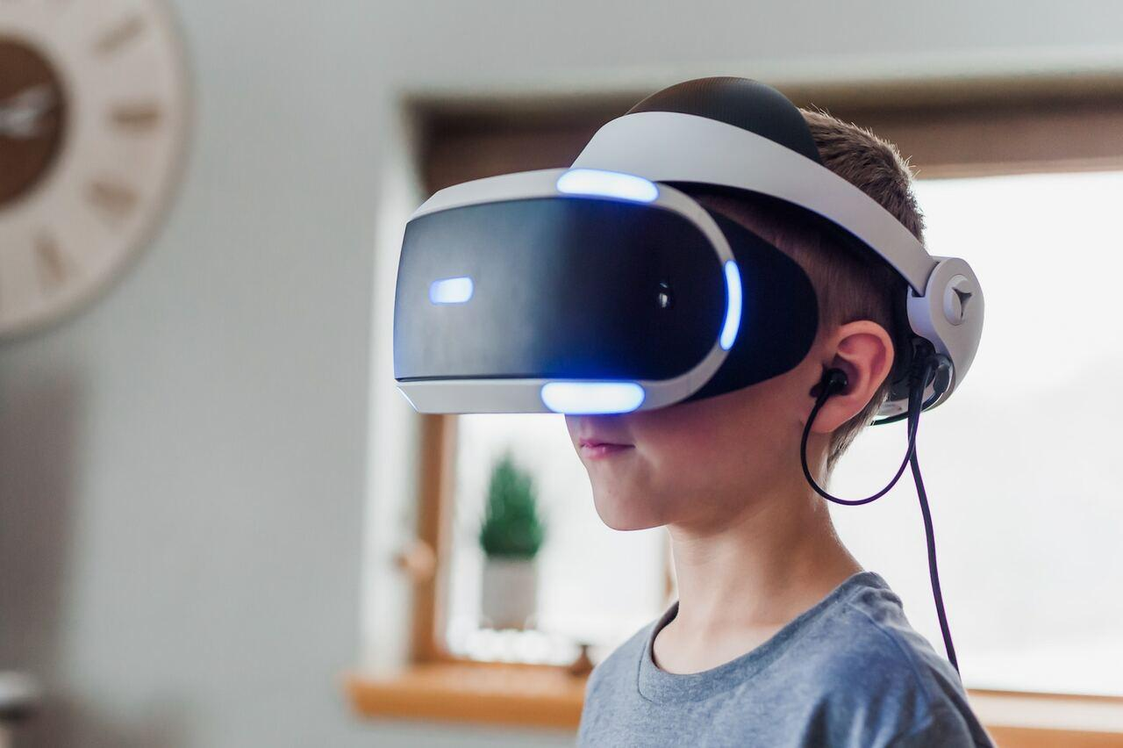
Output Devices in Computer Graphics
Monitors and Screens: The most common output devices, used to display images and videos.
Printers: For generating hard copies of graphics (2D or 3D).
Projectors: Used in large-scale displays for presentations and entertainment.
VR/AR Headsets: Immersive displays for virtual and augmented reality applications.

Slide 8
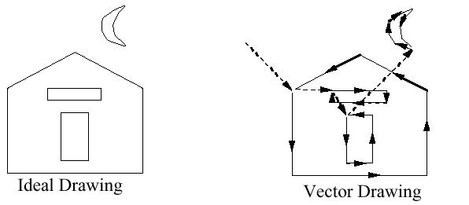

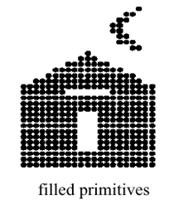
Graphics Display Hardware
Vector Display (calligraphic, stroke, random-scan)
Raster Display (TV, bitmap, pixmap) used in displays and laser printers
Driven by display commands
(move (x, y), char(“A”) , line(x, y)…)
Survives as “scalable vector graphics”
Driven by array of pixels (no semantics, lowest form of representation)
Note “jaggies” (aliasing errors) due to discrete sampling of continuous primitives
Ideal Drawing
Vector Drawing
Outline
Filled

Slide 9
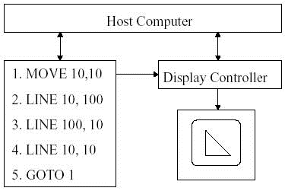
Output Technology: Vector Displays
Also called Calligraphic, Stroke or Line Drawing Graphics
Lines drawn directly on phosphor
Display processor directs electron beam according to list of lines defined in a "display list“
Phosphors glow for only a few microseconds so lines must be redrawn or refreshed constantly
Deflection speed limits # of lines that can be drawn without flicker.
Fig.: Vector Display Architecture

Slide 10
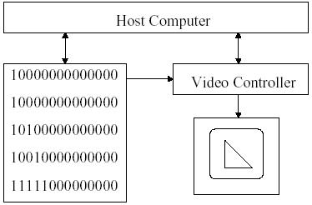
Output Technology: Raster Displays
Display primitives (lines, shaded regions, characters) stored as pixels in refresh buffer (or frame buffer)
Electron beam scans a regular pattern of horizontal raster lines connected by horizontal retrace and vertical retrace
Video controller coordinates the repeated scanning
Pixels are individual dots on a raster line
Fig.: Raster Display Architecture

Slide 11
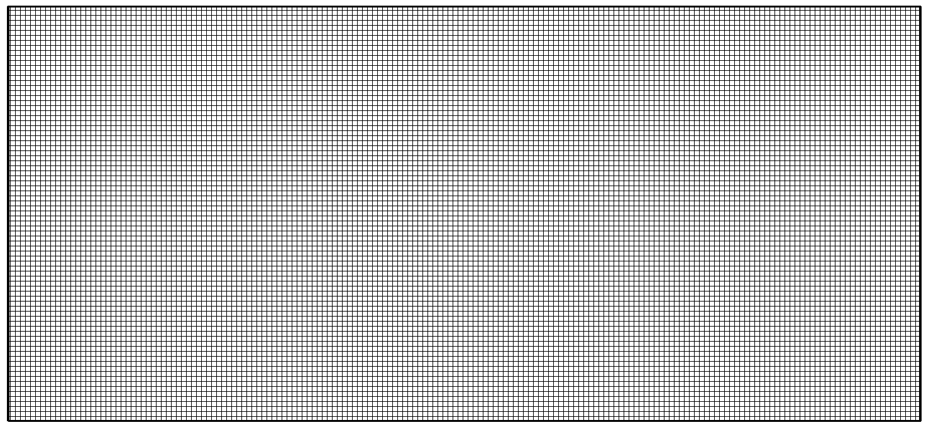
Basic Definitions
Raster: A rectangular array of points or dots.
Pixel (Pel): One dot or picture element of the raster
Pixel Grid: Images are arranged in a grid of pixels, where each pixel is stored with specific color information (RGB values)
Scan line: A row of pixels
Video raster devices display an image by sequentially drawing out the pixels of the scan lines that form the raster.

Slide 12
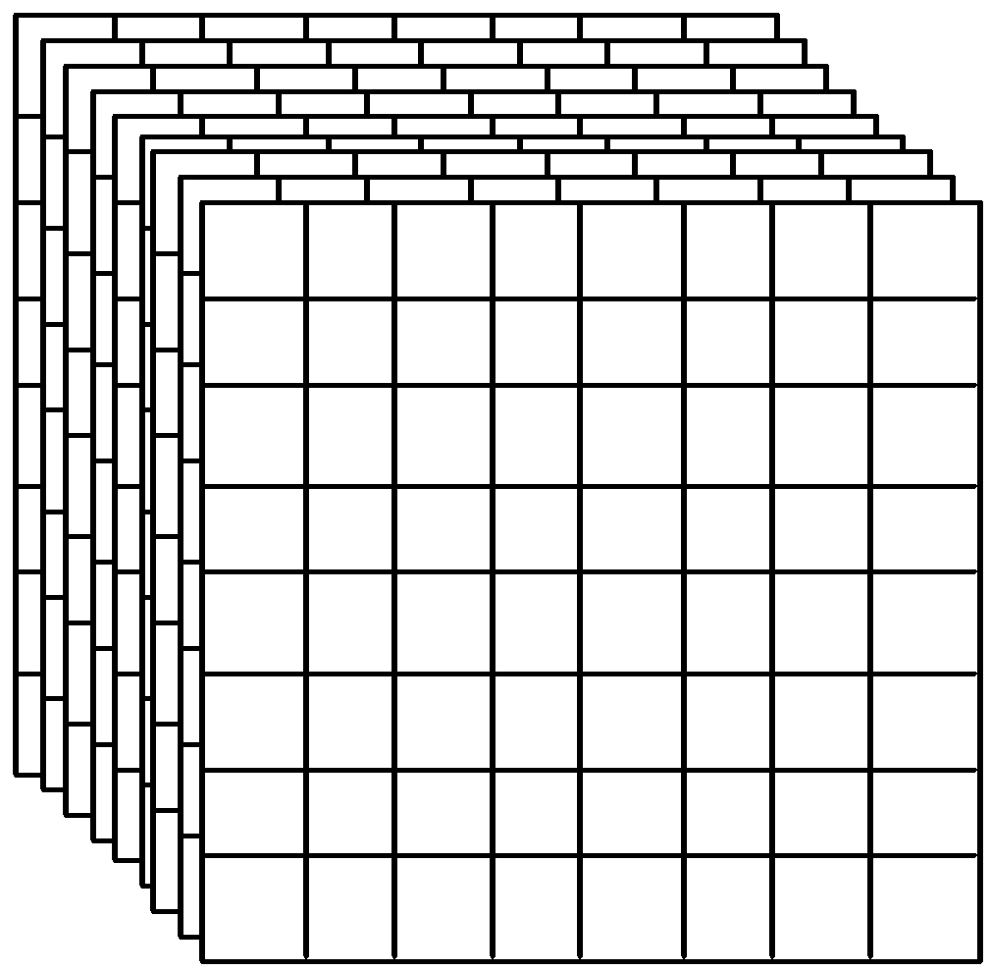
Frame Buffer
A frame buffer is characterized by its size, x, y, and pixel depth.
the resolution of a frame buffer is the number of pixels in the display. e.g. 1024x1024 pixels.
Bit Planes or Bit Depth is the number of bits corresponding to each pixel. This determines the color resolution of the buffer.
Dual ported (simultaneously writing values and displaying in the monitor)
Bilevel or monochrome displays have 1 bit/pixel (128Kbytes of RAM)
8bits/pixel -> 256 simultaneous colors 24bits/pixel -> 16 million simultaneous colors

Slide 13
Raster vs. Vector Displays
Raster: Pixel-based, fixed resolution, common in displays. Cheaper. More realistic.
Vector: Shape-based, resolution-independent, best for scalable designs.
Use Cases: Raster is used for photographs and complex images, while vector is used for fonts and logos.

Slide 14
Rendering Pipeline
The rendering pipeline is a sequence of steps used in computer graphics to convert a 3D scene into a 2D image on the screen.
Steps of the Rendering Pipeline:
Vertex Processing & Clipping
Transforms object coordinates → world → camera → screen coordinates using model, view, and projection transformations.
Performs basic lighting calculations (per-vertex lighting in fixed pipelines).
Clipping: Removes objects or parts of objects outside the camera can see ( view frustum)
Rasterization
Converts 3D primitives (like triangles, lines) into 2D fragments (potential pixels).
Determines which pixels are covered by each primitive and passes them to the next stage.

Slide 15
Rendering Pipeline
3. Fragment (Pixel) Processing
Applies shading, textures, and lighting (per-pixel lighting in modern shader pipelines).
Performs depth testing, transparency, reflection, and other pixel-level effects.
4. Image Composition / Output Merging
Combines fragments from all objects into the final image.
Applies depth buffering (Z-buffer), blending, and anti-aliasing.
Outputs the result to the framebuffer for display on the screen.

Slide 16
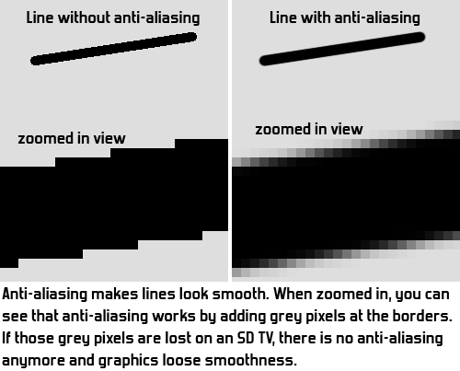
Antialiasing
Aliasing
Approximating a continuous entity with discrete samples
Jagging / staircasing effect
Result of an all-or-nothing approach to scan conversion
Each pixel is either colored or left unchanged
Antialiasing
The application of techniques that reduce or eliminate aliasing

Slide 17
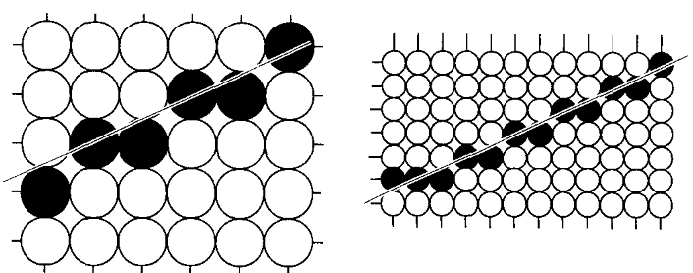
Antialiasing Techniques
Increase Screen Resolution
Costly
Only diminishes, does not solve
Higher memory
More time for scan-conversion
(a) res. W x H (b) res. 2W X 2H
Area Sampling
Unweighted Area Sampling
Weighted Area Sampling

Slide 18
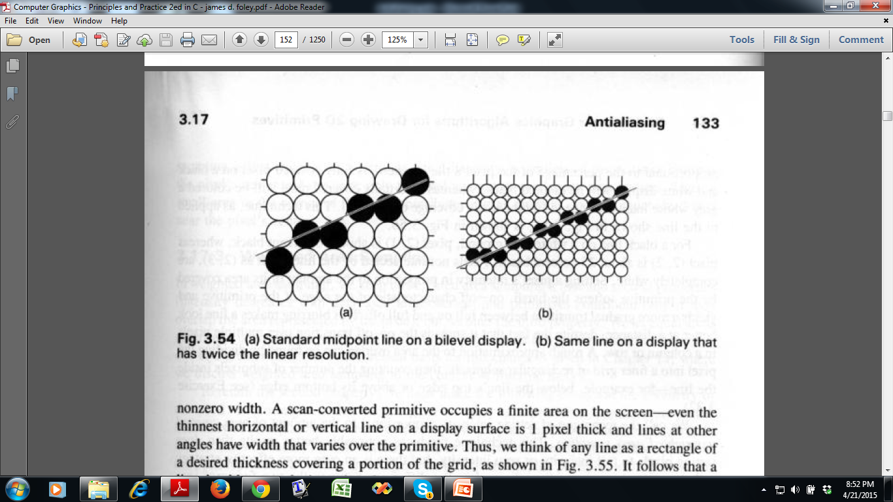
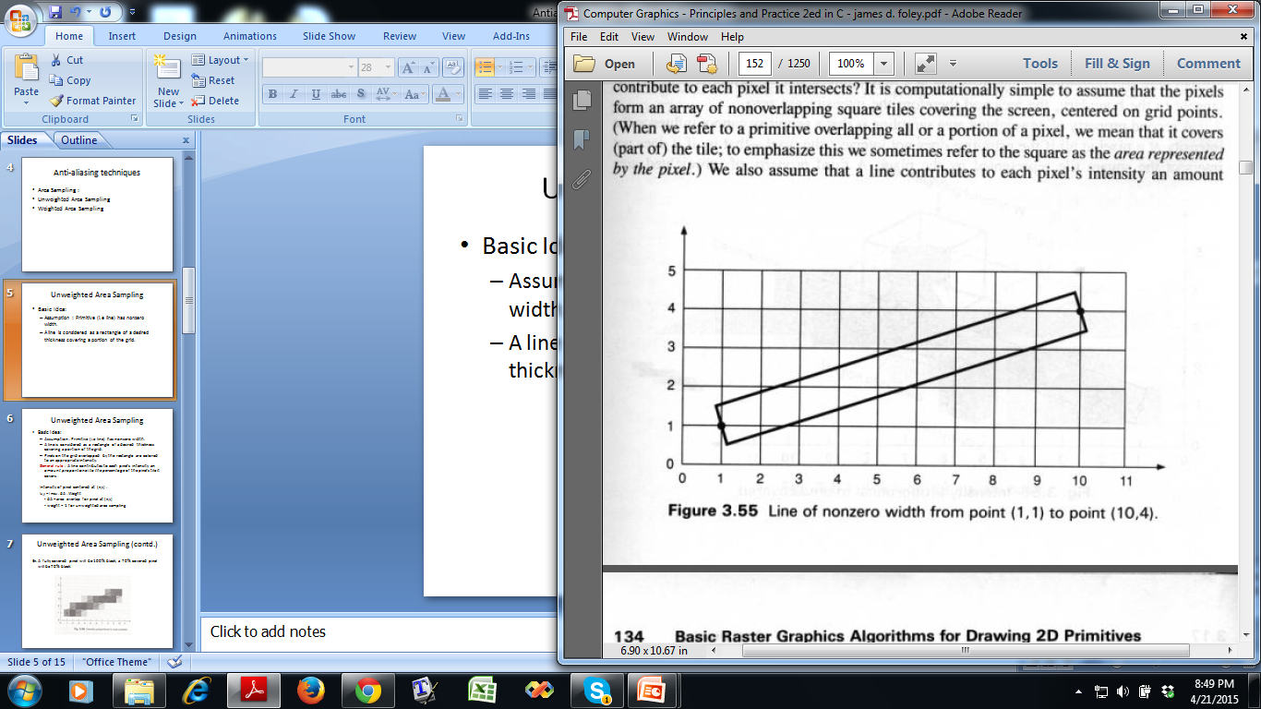
Unweighted Area Sampling
Basic Idea:
Horizontal or vertical line passes through one pixel per row or column
Lines at other angles go through multiple pixels per row or column
A line is considered as a rectangle of a desired thickness covering a portion of the grid

Slide 19
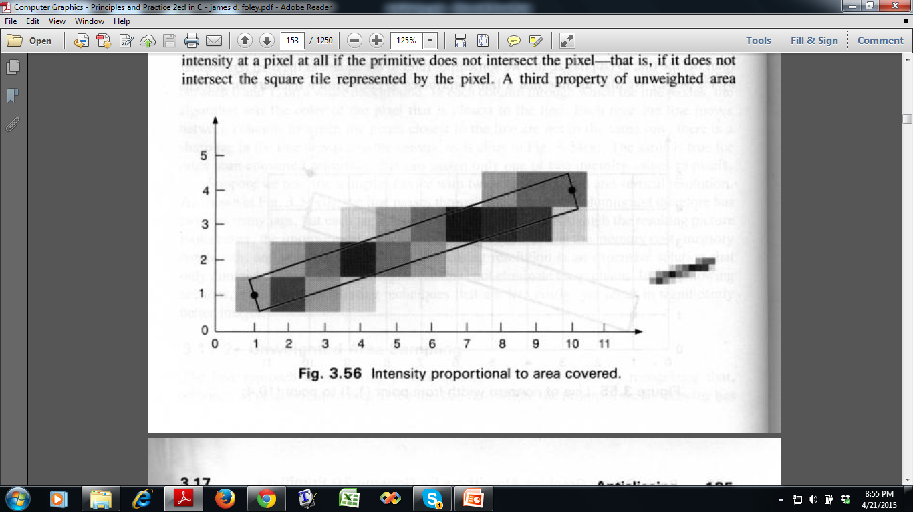
Unweighted Area Sampling
Basic Idea:
Pixels on the grid overlapped by the rectangle are colored to an appropriate intensity. General rule : A line contributes to each pixel’s intensity an amount proportional to the percentage of the pixel’s tile it covers.
75%
25%
95%

Slide 20
Intensity of pixel centered at (x,y) :
I_{x,y} = I _{max} . dA . Weight
dA = area overlap for pixel at (x,y)
Weight = 1 for unweighted area sampling

